Slide 1

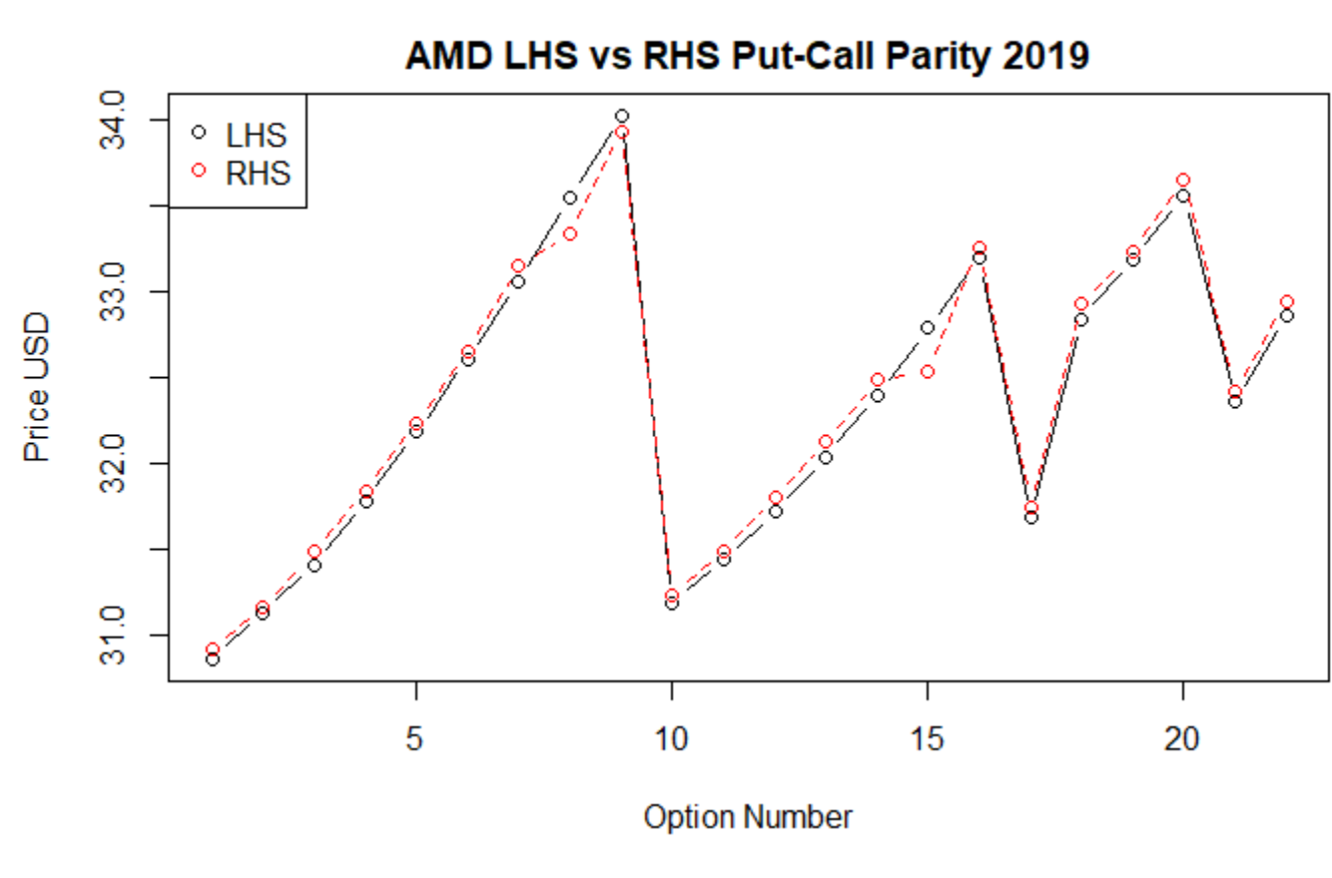

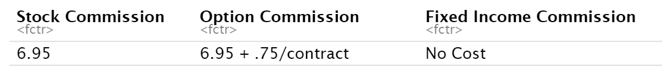
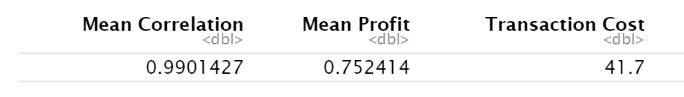
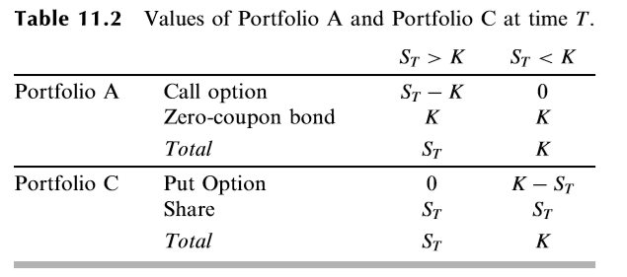
Applying The Put-Call Parity
Gregory Giordano and SMB Capital Trader
Pinnacle Scholars Summer Research Program 2019
Introduction
Application of Put-Call Parity
Data Collection and Strategy:
Data Collection
To apply the Put-Call Parity in the live market, we utilized R for both gathering data and trading strategies. To gather data, we used the R libraries Quantmod and Rvest. Quantmod enabled access to option chains from Yahoo Finance and Rvest enabled us to implement a web-scraping algorithm to gather live-stock and LIBOR data. We chose 15 non-dividend paying stocks in the S&P 500 to run our strategy.
Strategy
We chose to deal only with options expiring in 2019 due to uncertainty regarding the future market environment. Since the left-hand side (LHS) of the Put-Call Parity should be equivalent to the right-hand side (RHS), if the LHS was less than the RHS, we tested a strategy that would long a call option, short the stock and put option and invest the proceeds at the risk-free rate. If the RHS was less than the LHS, then we tested the results of longing the stock and put option by borrowing at the risk-free rate and shorting the call option. To provide context of how the LHS and RHS model each other and where opportunities for arbitrage (risk-free profit) arise, below is a graph of testing AMD’s LHS and RHS values. Arbitrage is available when the lines diverge
Analysis for Retail Traders with TD Ameritrade
While arbitrage opportunities are virtually impossible for retail traders to obtain, using TD Ameritrade’s commission costs as a baseline, we can see how the application of the Put-Call Parity could work.
Since commissions are $6.95 for each trade, on a typical application of the strategy, a trader would have to pay $41.70. Also, finding a way to be able to easily borrow and invest at LIBOR over the wanted time periods is very difficult.
Utilizing the Put-Call Parity is a heavily talked about subject in Finance
Finding real opportunities to apply the Put-Call Parity to make a profit is rare
Objective: Create a model to analyze actual applications of the Put-Call Parity using live data
Put-Call Parity
Background:
C : The current cost of a call option
K : The strike price of both the call and put option
r : The risk-free rate (LIBOR)
T : The time until expiration of the options
S : The current stock price
P: The current cost of a put option
Theory of Put-Call Parity:
The theory behind the Put-Call Parity depends on the assumption you have a stock that does not pay a dividend, a call and put with the same strike price and expiration date, and access to borrow at/invest at the risk-free rate (LIBOR). The parity is derived by considering two portfolios (A and C):
A. A call option plus a zero-coupon bond that provides a payoff of the strike price at time T
C. A put option plus one share of the stock
In portfolio A, if the stock price S at time T is above the strike, then the portfolio is worth (S – K) + K = S at time T. If S is less than K, then the portfolio will only be worth K at T because the call will expire worthless.
In portfolio C, if the stock is below the strike at T, then the portfolio will be worth (K-S) + S = K. If S is greater than K, then the put option in portfolio C will be worthless and the portfolio will be worth S.
Therefore, the two portfolios are theoretically equivalent in value.
Results
After building an R script to sort through the data of the non-dividend paying stocks, we see the average correlation between the LHS and RHS of the Put-Call Parity was .9901427. While the correlation is very close to 1, the slight discrepancy enables traders to capture an opportunity. On average, while using 1 stock share, 1 call option, and 1 put option, a trader could possibly make $0.752 from the strategy. Thus, the $0.752 could be scaled by increasing quantity and ultimately leading to a profit. The future research will have to discuss the plausibility of a retail trader in capturing the opportunity with necessary executions.

